Slide 1




Notes:
*

Slide 2


UI ENGINEERING STUDIO
UI Engineering Studio. Day 12 Bootcamp: Redux

Slide 3


UI ENGINEERING STUDIO
Redux
Predictable state container for JS applications.
Why Redux?
Helps us to write apps with a consistent behaviour
It can be executed in different environments
Easy testing
Just 2kb
Data Flow​
​Actions​
​Reducers​
Store​
Notes:
our code must manage more state than ever before
lost control over the when, why, and how of its state: hard to reproduce: bugs
new requirements becoming common in front-end product development: optimistic update
we're mixing two concepts that are very hard for the human mind to reason about: mutation and asynchronicity
Redux attempts to make state mutations predictable by imposing certain restrictions on how and when updates can happen.

Slide 4
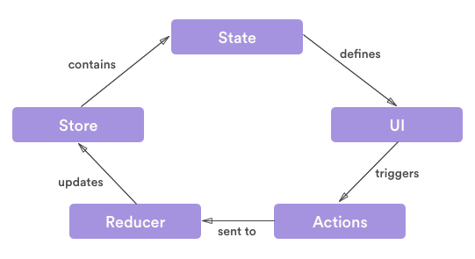
UI ENGINEERING STUDIO
UI Boot Camp: Redux Data Flow

Slide 5
UI ENGINEERING STUDIO
UI Boot Camp: Redux Data Flow
Redux architecture revolves around a strict unidirectional data flow. The lifecycle is:
You call store.dispatch(action).
The Redux store calls the reducer function you gave it.
The root reducer may combine the output of multiple reducers into a single state tree.
The Redux store saves the complete state tree returned by the root reducer.

Slide 6
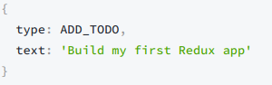
UI ENGINEERING STUDIO
UI Boot Camp: Redux Actions
Payloads of information
The only source of information for the store
Send them using store.dispatch().
They describe WHAT happens

Slide 7
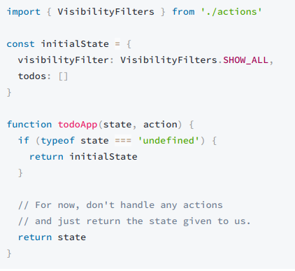
UI ENGINEERING STUDIO
UI Boot Camp: Redux Reducers
Specify HOW the application's state changes in response to actions sent to the store.

Slide 8
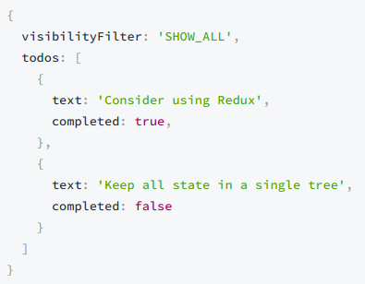
UI ENGINEERING STUDIO
UI Boot Camp: Redux Store
The Store is the object that brings Actions and Reducers together.

Slide 9
UI ENGINEERING STUDIO
UI Boot Camp: Redux Redux
https://codepen.io/dmiller5383/pen/awQaZg?editors=0010

Slide 10

UI ENGINEERING STUDIO
UI Boot Camp: Redux Homework!
We’re going to continue with the TODO list.
Let’s implement Redux :D

Slide 11
Notes:
*

